Slide 1
organic chemistry visualiser
Getting started

Slide 2
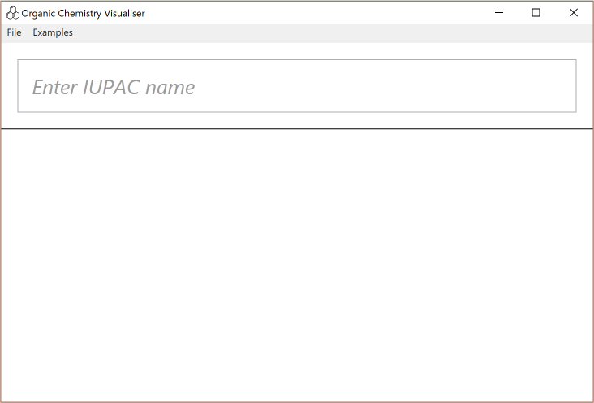
Enter IUPAC names here
Click to enter ‘cyclohexane’ in the textbox

Slide 3
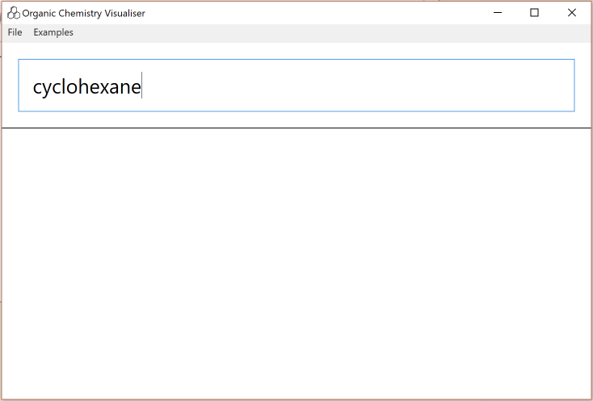
Press ‘enter’ to display the compound
Click to press enter

Slide 4
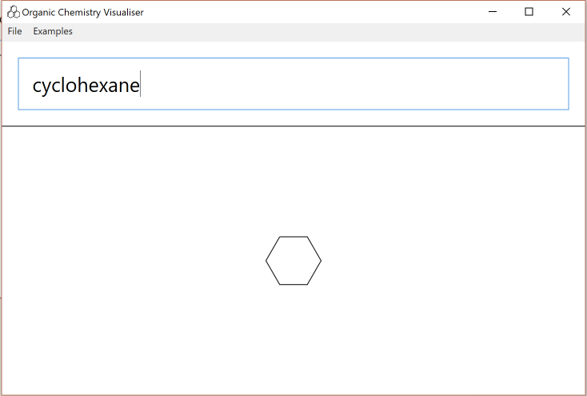
Looks great! Click the ‘File’ menu to see the actions available.

Slide 5
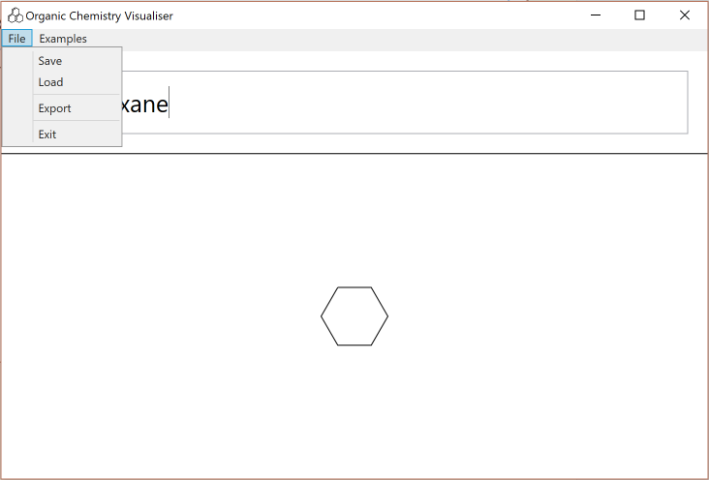
The ‘save’ and ‘load’ menu items can save and load your compound.
The ‘export’ menu item can export your compound as either a PNG or JPG picture file.
The ‘exit’ menu item exits Organic Chemistry Visualiser.

Slide 6
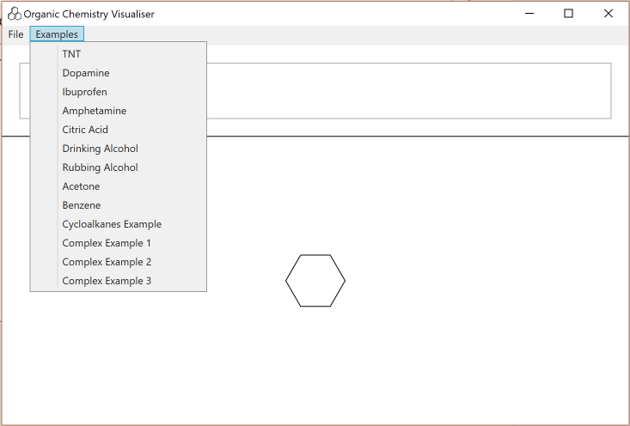
These are all examples of Organic Compounds that can be displayed. Select ‘TNT’.

Slide 7
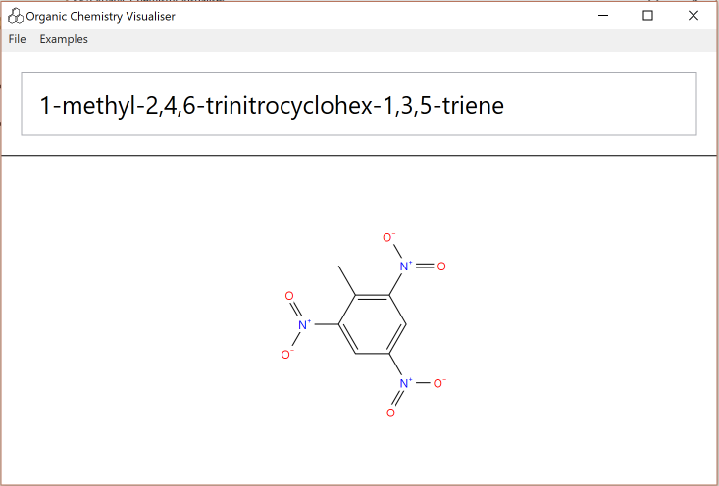
There you go! That’s all you need to know to start using OCV. To finish off, select the ‘Examples’ menu once more and then select ‘Complex Example 1’

Slide 8
There you go! That’s all you need to know to start using OCV. To finish off, select the ‘Examples’ menu once more and then select ‘Complex Example 1’

Slide 9
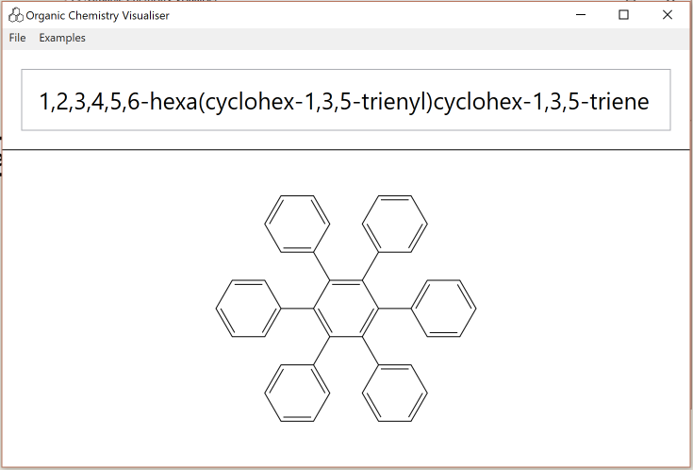
Wow! What wacky compounds can you make with Organic Chemistry Visualiser?

